Slide 1

one-Q-shop
Dominic Silveira 171032
Joel Monis 171044
Lenin Bardeskar 171057
Date of presentation: 27 May 2021
Under the guidance of: Ms. Amrita Mathur
St. Francis Institute of Technology
Department of Information Technology

Slide 2

Content
Introduction
Review of Literature
Problem Definition & Objectives
Proposed Solution
Scope of Project
System Description
Architecture or block diagram
Explanation of individual blocks
Hardware & Software Requirements

Slide 3
Introduction
The conventional shopping process is very time-consuming and cumbersome for the sick, the elderly and families with toddlers.
Online shopping businesses easily gather data about user behavior, choices and opinion. Long queues and crowded stores may drive away customers.
The proposed solution is cheaper to implement as well as faster than handheld scanners, which have been in use in supermarkets and wholesale stores.
An android based M-commerce application that would help improve the conventional shopping experience while helping businesses to increase their customer base and revenue.

Slide 4
Review of Literature (Algorithms)
It adapts the content based on user preferences and the content viewed by the user. It is also built for showing items from similar users after the first login to decrease the effect of cold start problem.
Aspect ranking of products to identify and prioritize the aspects of products based on the online reviews given by the customers. The product aspects are extracted and then the opinions on those aspects are identified via sentiment dictionaries, finally the aspects are ranked based on their sentiment score.
Content-based filtering subjectivity covered factor drawback was solved in collaborative-filtering. The users should state whether they like the recommendation or not, to improve the recommendation. Personal recommendation is only preferred by the user who already did some activities like rate or view an item.

Slide 5
Problem Definition & Objectives
Shopping malls and avenues are popular places for shopping trips. They are becoming increasingly crowded - there are long queues at the checkouts, especially on weekends and during festive seasons.
Online shopping businesses easily gather data about user behavior, choices and opinion, hence target audience better.
This project aims to develop an Android Application that provides shopping assistance to customers in a mall by automating the billing process using bar-code as well as give recommendations to users based on their shopping patterns.

Slide 6
Proposed Solution
An Android Application that provides shopping assistance to customers in shopping malls by automating the billing process using bar-code as well as give recommendations to users based on their shopping patterns.
Users can scan the product barcode to get complete details of the product and add the product to the cart.
Recommendations based on user behavior.
Instant cashless payments using UPI, Payment gateway without having to wait in the billing queue.
Direct home delivery or scheduled pickup.

Slide 7
Scope of Project
The proposed technology can be used in shopping malls and can be further customized according to the needs of a shop.
The user also has the option to pay through the inbuilt payment gateway so as to not waste time at the checkout queues.
We can enhance the application further by adding new products and updating the existing products information depending upon market scenario in the applications database.

Slide 8
System Description
.
one-Q-shop
SignUp
SignIn
Customer
Owner
Homepage
Scan
Profile
Add/Delete product
Browse products
Scan barcode
Personal Details
Open Report/History
Recommended products
Add to cart
UPI Details
New offers,etc
Check billing amount
Change Password
Payment Gateway
Notifications
Open paid Bill
About App
Logout

Slide 9
System Description
Users can scan the product barcode to get complete details of the product clearly without searching for information on the product and add the product to the cart.
Users will get recommendations based on the number of buys, ratings, number of views and reviews provided by the current user or other users.
Users will be able to checkout and make payment via UPI instead of standing in the queue. After which they can either choose for the product to be home delivered or opt for a scheduled pickup.

Slide 10
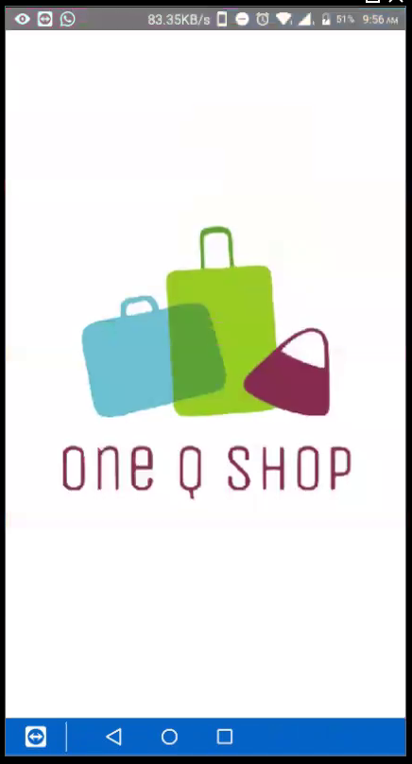
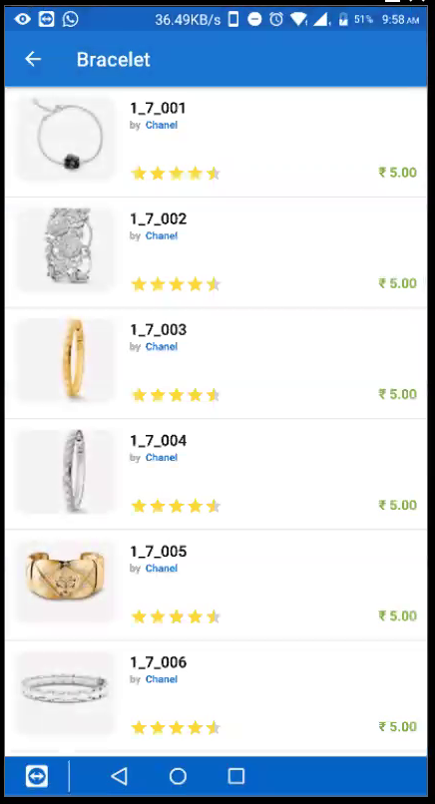
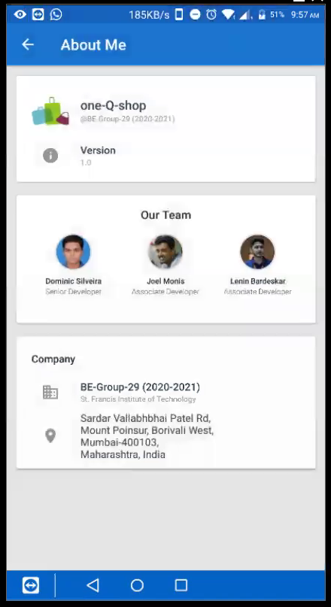
User Interface Design
.

Slide 11
Hardware & Software Requirements
Hardware Requirements:
A mobile phone with following specifications:
Internal Memory: 8GB or above.
RAM: Minimum 2GB.
Operating System: Android.
PC with standard specifications.
Barcodes.

Slide 12
Hardware & Software Requirements
Software Requirements:
Git
Windows/Linux OS
Android Studio
VS Code
MySQL Workbench
Postman
Chrome/Firefox Browser

Slide 13
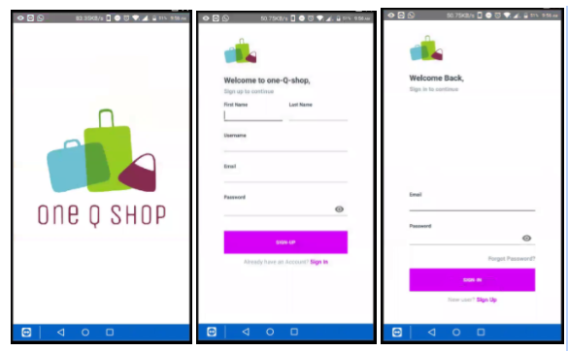
Implementation and Results
Homepage Registration Login

Slide 14
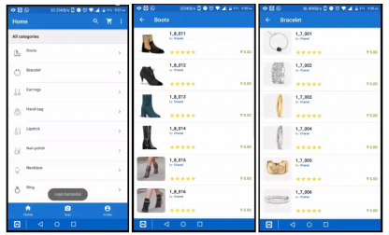
Implementation and Results
Searching products by categories

Slide 15
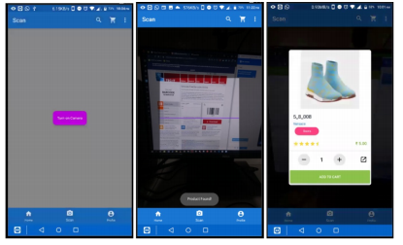
Implementation and Results
Scanning of a barcode and adding product to cart

Slide 16
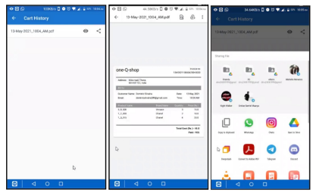
Implementation and Results
Cart history and billing invoice

Slide 17
Conclusions
One-Q-Shop aims at facilitating the shopping process while not hampering the customer’s shopping experience. Predictions made by the recommendation system helps customers get similar and related products without having to manually search for them. All-inclusive, One-Q-Shop helps provide a safe, fast, easy yet the same old shopping
experience in a post-pandemic world to each and every customer in their shopping journey

Slide 18
References
Bogdan Walek, Petra Spackova, “Content-based recommender system for online stores using expert system”, IEEE First International Conference on Artificial Intelligence and Knowledge Engineering (AIKE), 2018
T.Sangeetha, Mr.N.Balaganesh, Dr.K.Muneeswaran, “Aspects based Opinion Mining from Online Reviews for Product Recommendation”, International Conference on Computational Intelligence in Data Science(ICCIDS), 2017
Ade Romadhony, Said Al Faraby, Bambang Pudjoatmodjo, “Online Shopping Recommender System Using Hybrid Method”, International Conference of Information and Communication Technology (ICoICT), 2013

Slide 19
Questions??
Thank You!

